Slide 1
Development of Floor Level Material Transfer Mobile Robot
Batch No. MRP02
Project Members
Lalithesh K (RA2211038010007)
Tejas M K (RA2211038010012)
Preetham M (RA2211038010046)
Under the Guidance of
Dr. R. Senthilnathan M.E., Ph.D.

Slide 2
Project Objective
The primary objective is to develop an autonomous indoor delivery robot capable of transporting materials between designated locations (Entrances of various rooms) within a single floor of a building (Hi-tech 2nd Floor).
The various tasks to accomplish the objective are:
To implement mapping and localization using onboard sensors, enabling the robot to autonomously navigate and plan optimal paths within its environment.
To enable safe and reliable navigation and path planning, ensuring the robot can operate in dynamic environments and maintain a safe coexistence with human activity.
To develop a user-friendly interface for assigning pickup and drop-off tasks, providing intuitive interaction and real-time status monitoring.
The secondary objectives are:
To integrate an autonomous docking mechanism that allows the robot to return to a charging station and recharge automatically when the battery level is low.
To design and implement a developer dashboard that provides remote monitoring, manual pilot control, and system diagnostics for maintenance and performance evaluation.
21MHP401L/403L - Major Project

Slide 3
High Level System Block Diagram
Charge Monitoring and Docking
Override delivery tasks if charge low
Mapping & Localisation Module
User Interface
Mission/Task Manager
Perception Module
Pickup & Dropoff
Arrival for Pickup or Dropoff
Global Planner
Obstacle Detection Module
Map
Alerts & Notification System
Dynamic Obstacle in Path
Control Module
Local Planner

Slide 4
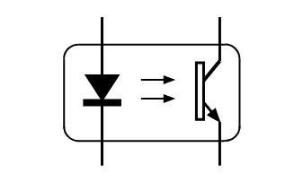
Hardware Block Diagram
IMU (Inbuilt with ZED Camera)
5V
Slip Compensation
12V
USB
Wi-Fi Module
360 Servo Motor
ZED Mini Stereo Camera
UART
Primary Perception
Jetson Nano
Motor Driver
Digital
Single Point Solid State LIDAR
Direction
Proximity Detection
Speed
PWM
Cliff Detection
Motor Encoders
Motor
Analog
Ultrasonic Sensor
Mechanical Coupling
Sensor
Adapter
DC to AC Converter
Power System
Charge State
Power Distribution Board
Discharge State
Actuation System
Charging Module
Charging
Battery
Communication System

Slide 5
Methodology
System Architecture and Environment Setup
Structural Modifications and Charging Equipment
Mapping and Localization
Navigation and Task Handling
User Interface Development & Integration
Testing and Validation
21MHP401L/403L - Major Project

Slide 6
Components procured with Price details
S.No | Component Name | Specification | Price /piece (INR) | Quantity required | Total Cost (INR)
1 | Tanna Techbizz Eagle 101 | 4GB | Borrowed from Lab | 1 | NA
2 | Ultrasonic Sensor | HC-SR04 | Borrowed from Lab | 2 | NA
3 | Single Point Solid State LIDAR | Tfmini-Plus | Borrowed from Lab | 1 | NA
4 | LiPO Battery | 10000mah | 5,115 | 1 | 5115
5 | Zed Mini |  | Borrowed from Lab | 1 | NA
6 | DC to AC Inverter | 12V 200W | 1249 | 1 | 1249
7 | Optoisolator | TLP281 | 67 | 3 | 201
8 | Logic Level Shifter | TXS0108E | 168 | 2 | 336
9 | Electrical Connectors |  | 300 |  | 300
10 | Carbon Fiber Tubes, Carbon Fiber Plates, & Arcylic Sheets |  | 7000 | 4 + 2 | 7000
11 | 3D Printing Filament | PLA+ | 996 | 1 | 996

Slide 7

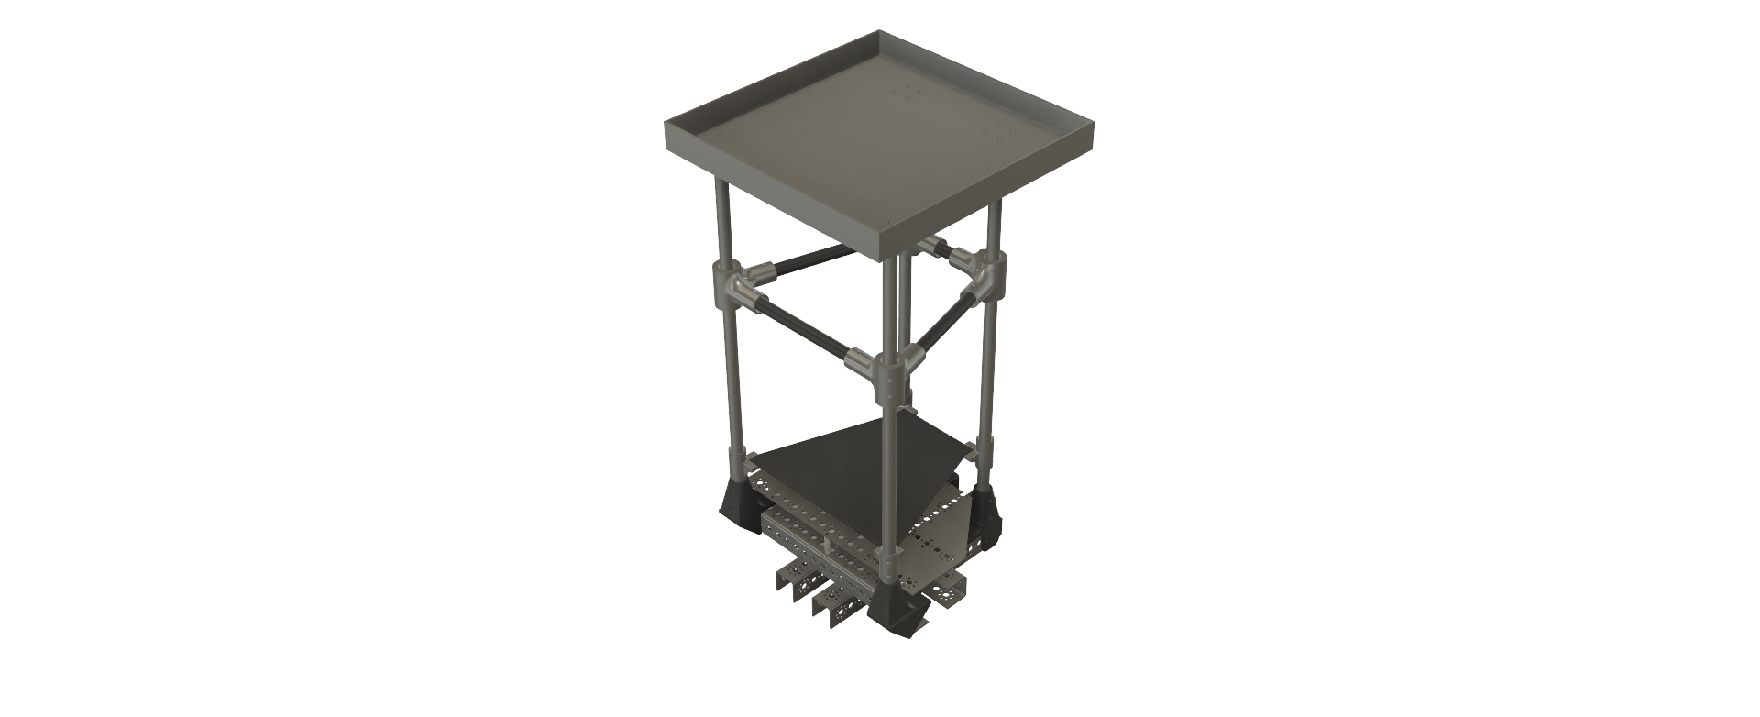
Progress after zeroth review
CAD:
CHALLENGES:
Safer Human-Robot Interaction.
Risk of Toppling Due to Height Extension.
Structural Wobbling
Added Payload & Motor Overload.
SOLUTIONS:
Lightweight Material Selection to Avoid Motor Overload and Decrease the risk of toppling.
Rigid Structural Frame for reduced wobbling and better stability.

Slide 8
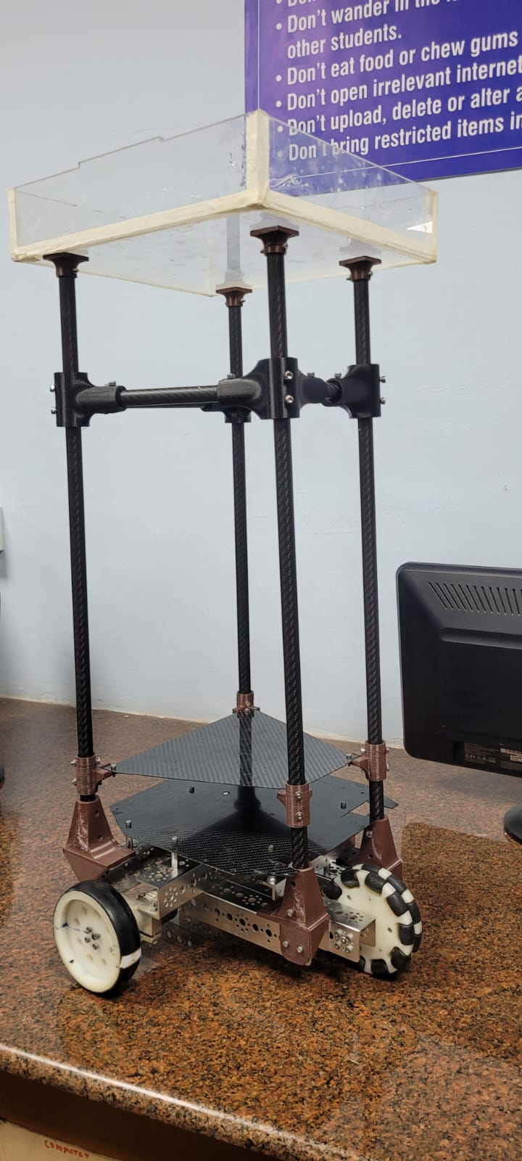
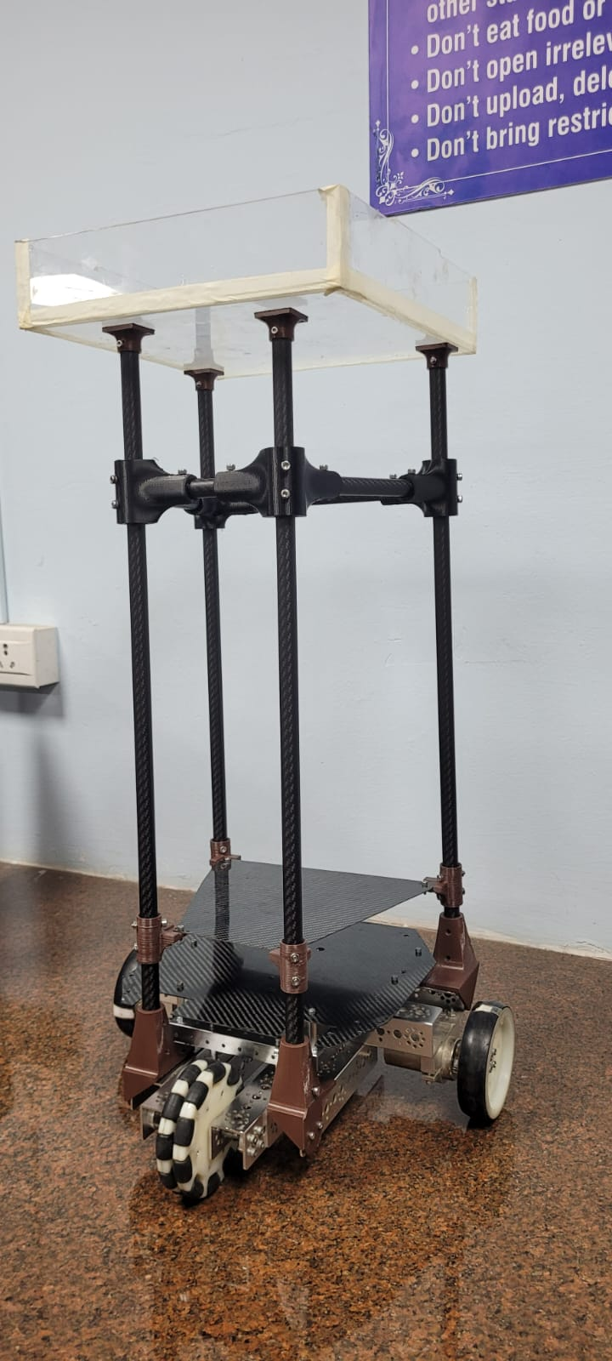
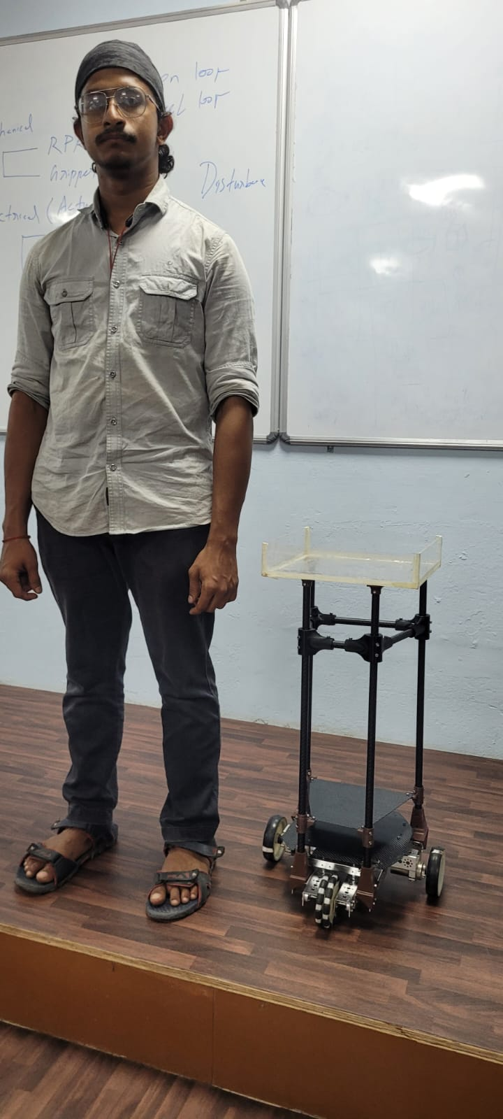
Fabrication:
3 ft

Slide 9
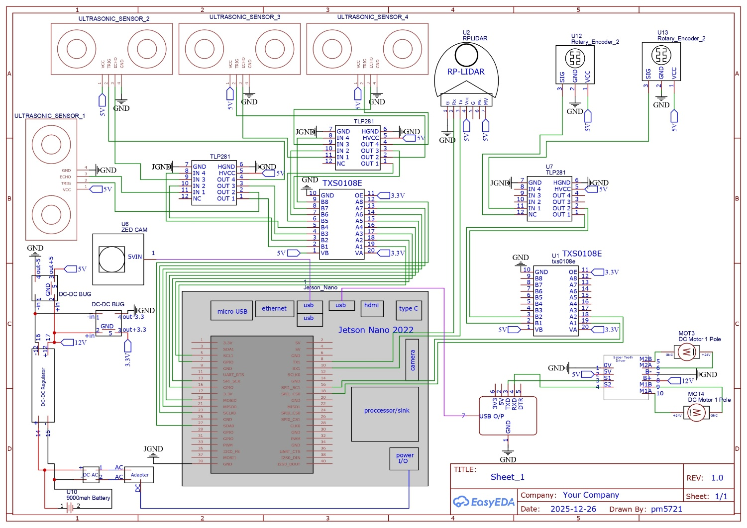
Circuit Schematic:
Objectives:
Centralized High-Level Processing and Control.
Safe and Regulated Power Distribution.
Electrical Isolation with opto-isolators to protect jetson from current charges

Slide 10
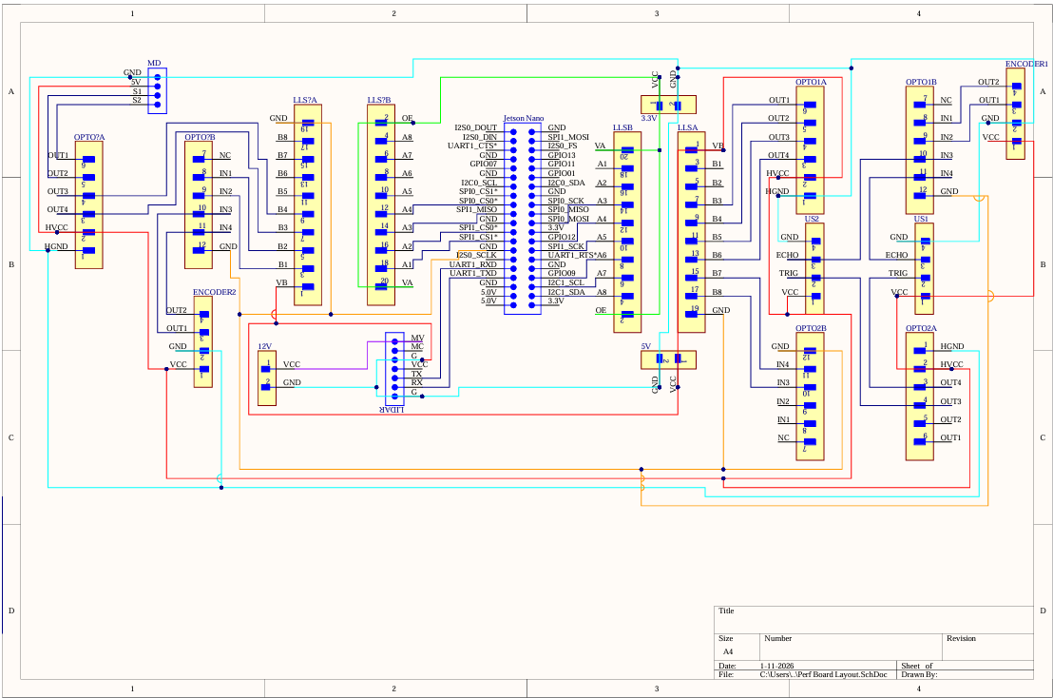
PCB Layout Schematic
Objective
To plan physical component placement on a perfboard
To minimize wire length and crossovers
To ensure correct pin mapping before soldering
To reduce wiring errors during manual assembly

Slide 11
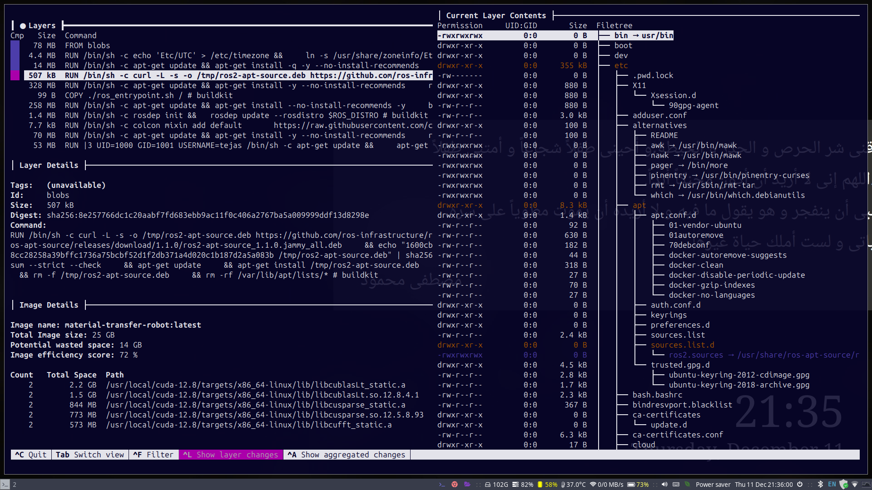
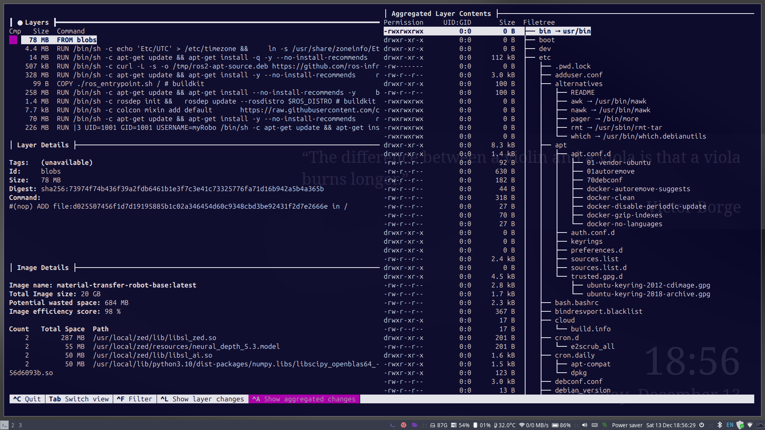
3) Dockerized Multi-System Architecture
Objective
Use these bullets verbatim if you want:
Ensure reproducible builds across different machines
Support cross-platform deployment (x86_64 & ARM)
Isolate dependencies for ROS2, vision, and navigation stacks
Enable consistent development across team systems
Problem Being Solved
Different OS versions across systems
Dependency conflicts in ROS2 & OpenCV
Reproducibility guarantee
Architecture mismatch (Jetson ARM vs laptop x86)
Architecture
Base Docker images defined per architecture
Multi-stage builds for efficiency
Same source code, different target architectures
Containers run identical software stacks on all systems

Slide 12
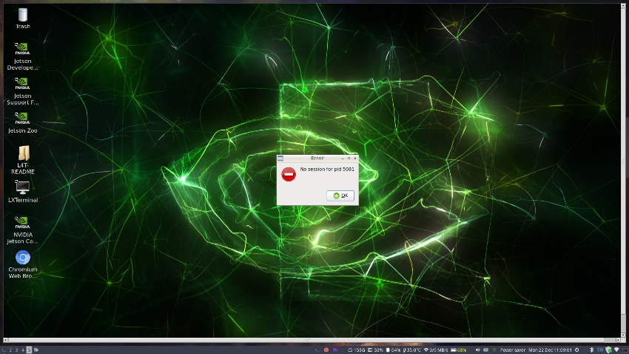
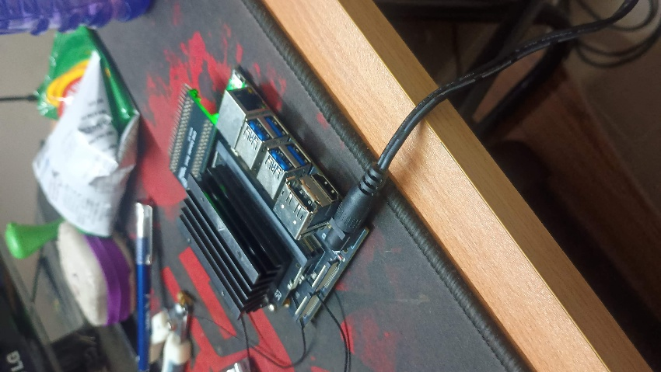
3) Jetson System Setup & Container Deployment
Objective
Prepare Jetson as the target execution platform
Enable headless access and remote development
Ensure identical runtime environment as development systems.
System Setup
Jetson OS installed and configured
Network-based remote access enabled via VNC
Jetson used as ARM-based deployment node

Slide 13
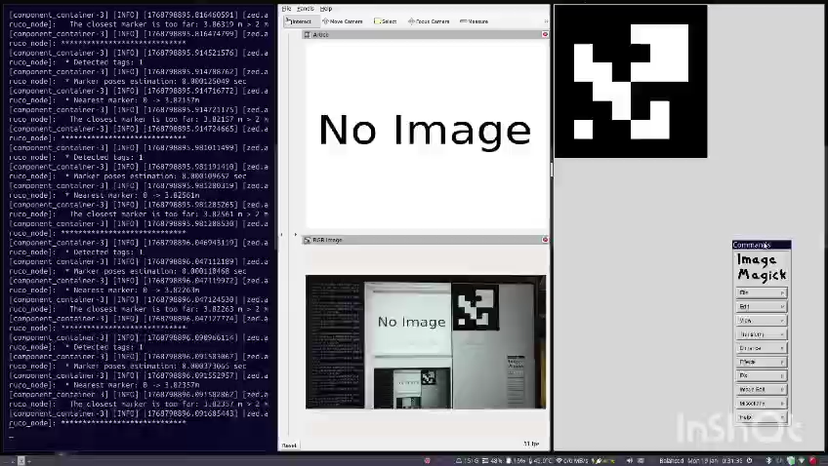
2) Aruco Marker Based Localisation
Task
Implement vision-based localization correction for indoor navigation
Objective
Reduce accumulated drift from wheel odometry
Provide absolute pose reference at known locations
Improve long-corridor localization reliability
Allow reference for map switching logic triggers
Algorithm
Capture image from onboard camera
Detect ArUco markers in the scene
Estimate marker pose relative to camera
Transform pose to camera frame
Publish corrected pose to ROS2 localization stack

Slide 14
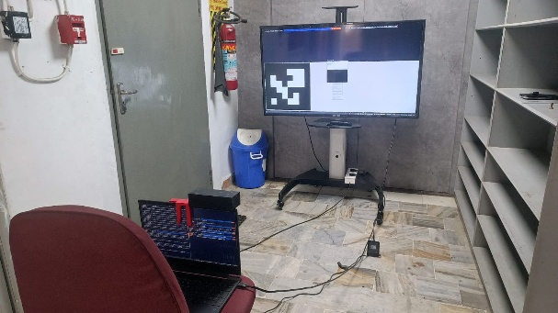
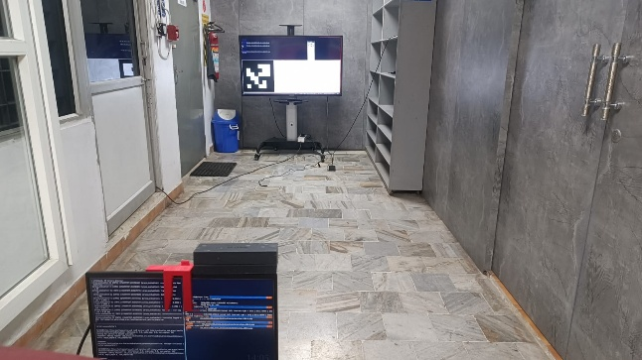
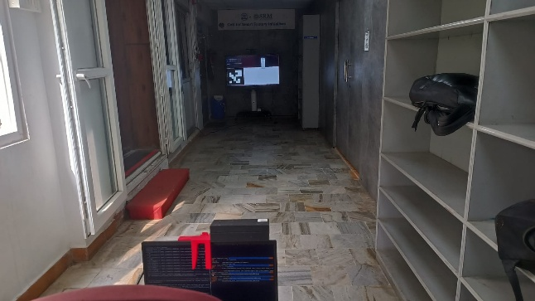
3) Aruco Marker Evaluation
Objective of Evaluation
Quantify pose accuracy of ArUco-based localization
Measure consistency across repeated detections
Validate suitability for indoor corridor use
Evaluation Setup
Camera placed at known distances from marker
Ground truth measured manually (tape / reference point)
ArUco pose estimated via service call
Results logged per request in CSV

Slide 15
3) Aruco Marker Evaluation
Results
Average position error: 5.49 m
Maximum observed error: 9.55 m
Reliable detection range: 8 m
Observations / Limitations
Accuracy decreases with distance
Sensitive to lighting conditions
Marker orientation affects pose estimation
Metrics Used
Position error (cm)
Detection success rate (%)
Pose variance across multiple calls
timestamp | marker_size_m | distance_m | angle_deg | samples_collected | frames_attempted | detection_ratio | mean_x_m | std_x_m | mean_y_m | std_y_m | mean_z_m | std_z_m | mean_yaw_deg | std_yaw_deg
29-12-2025 08:15 | 0.4 | 1 | 0 | 30 | 30 | 1 | -0.01766 | 0.000026 | -0.01168 | 0.00002 | 0.085327 | 0.00004 | 0.895558 | 0.057946
29-12-2025 08:18 | 0.4 | 2 | 0 | 30 | 30 | 1 | -0.01569 | 0.000007 | -0.01283 | 0.000008 | 0.164623 | 0.000176 | 0.863695 | 0.016923
29-12-2025 08:32 | 0.4 | 3 | 0 | 30 | 30 | 1 | -0.03867 | 0.00004 | -0.03295 | 0.000022 | 0.245569 | 0.000295 | -0.12783 | 0.082393
29-12-2025 08:33 | 0.4 | 4 | 0 | 30 | 30 | 1 | -0.03821 | 0.000118 | -0.03685 | 0.000164 | 0.323881 | 0.00088 | -0.32729 | 0.711507
29-12-2025 08:34 | 0.4 | 5 | 0 | 30 | 30 | 1 | -0.04125 | 0.000244 | -0.04277 | 0.000343 | 0.398162 | 0.001657 | -0.67372 | 0.834308
29-12-2025 08:36 | 0.4 | 6 | 0 | 30 | 30 | 1 | -0.0519 | 0.000222 | -0.05461 | 0.000292 | 0.476973 | 0.002602 | -1.0784 | 0.946208
29-12-2025 08:37 | 0.4 | 7 | 0 | 30 | 30 | 1 | -0.0519 | 0.000261 | -0.05781 | 0.000397 | 0.570992 | 0.002985 | 0.32444 | 0.578167
29-12-2025 08:38 | 0.4 | 8 | 0 | 30 | 30 | 1 | -0.07368 | 0.001553 | -0.06015 | 0.001507 | 0.659937 | 0.014497 | -0.07686 | 0.833511
29-12-2025 08:39 | 0.4 | 9 | 0 | 6 | 30 | 0.2 | -0.04653 | 0.000222 | -0.06807 | 0.000379 | 0.74019 | 0.003697 | -0.44158 | 1.10352
29-12-2025 08:40 | 0.4 | 10 | 0 | 5 | 30 | 0.166667 | -0.02687 | 0.000723 | -0.08104 | 0.003764 | 0.813137 | 0.032792 | -1.1174 | 1.456015
29-12-2025 09:12 | 0.5 | 2 | 0 | 30 | 30 | 1 | -0.01275 | 0.000199 | -0.02025 | 0.000311 | 0.094712 | 0.001449 | -0.20365 | 0.089955
29-12-2025 09:14 | 0.5 | 4 | 0 | 30 | 30 | 1 | -0.01597 | 0.000046 | -0.02445 | 0.000073 | 0.162625 | 0.000248 | -0.43427 | 0.086933
29-12-2025 09:15 | 0.5 | 6 | 0 | 30 | 30 | 1 | -0.01616 | 0.000037 | -0.03265 | 0.000087 | 0.266305 | 0.000281 | -0.35168 | 0.104623
29-12-2025 09:17 | 0.5 | 8 | 0 | 30 | 30 | 1 | -0.02408 | 0.000182 | -0.03351 | 0.000244 | 0.35805 | 0.002419 | 0.753986 | 0.336156
29-12-2025 09:29 | 0.5 | 9 | 0 | 3 | 30 | 0.1 | -0.0361 | 0.000014 | -0.11175 | 0.000764 | 0.395768 | 0.000273 | -0.5118 | 0.028253
29-12-2025 09:24 | 0.5 | 10 | 0 | 3 | 30 | 0.1 | -0.02496 | 0.000605 | -0.10539 | 0.000906 | 0.451485 | 0.00654 | -2.76884 | 0.276821

Slide 16
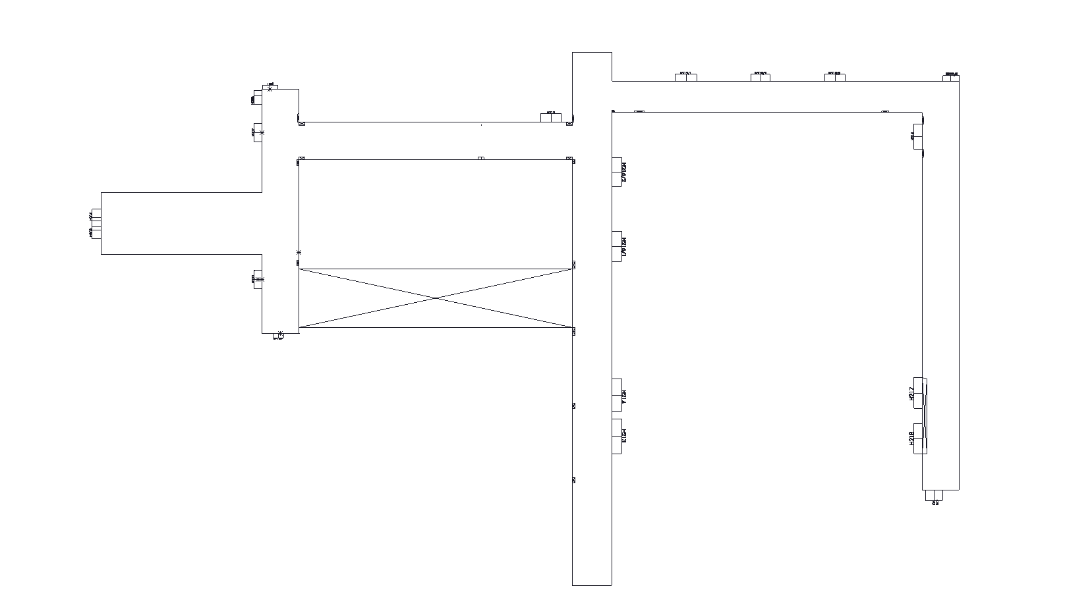
Map Creation-Hitech second floor 2D-Map:
Challenges:
Low traversable area resolution:
Loss of spatial detail in the environment map
Reduced navigation accuracy near boundaries and obstacles
Increased localization uncertainty
Impact on localization:
Particle filter operates over a larger state space
Slower convergence to the correct pose
Higher probability of false localization

Slide 17
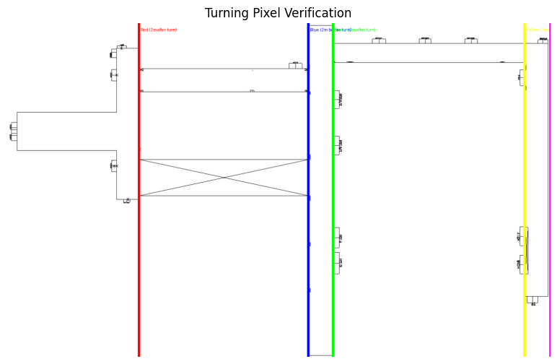
SOLUTION:
Splitting a single large map into smaller tiles enables:
Higher effective resolution
More pixels per meter
Improved spatial detail
Corridors appear thicker and clearer
Improved localization & navigation
AMCL particles constrained to relevant regions
Faster particle convergence
Reduced localization ambiguity
More efficient planning
Smaller costmaps
Faster path planning
Lower computational load

Slide 18
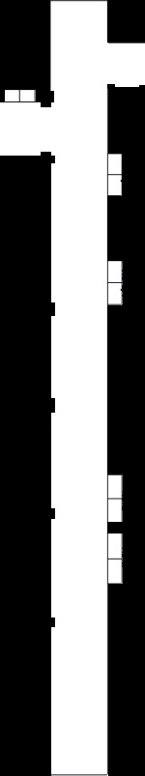
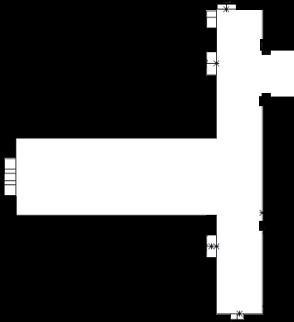

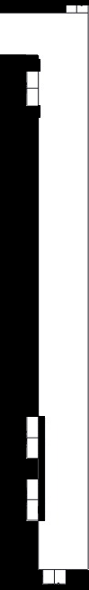

CONVERTING THE TILES TO PNG AND PGM+YAML FORMAT:
TILE 4
TILE 2
TILE 1
TILE 3
TILE 5

Slide 19
Map Switching Logic Development:
1)Map Server publishes the active occupancy grid (/map)
2)AMCL localizes the robot within the active map
3)Nav2 plans paths using the current map and localization
4)A custom Tile Switcher node:
Monitors robot motion
Detects boundary crossing
Commands map server to load the next tile
Resets localization safely

Slide 20
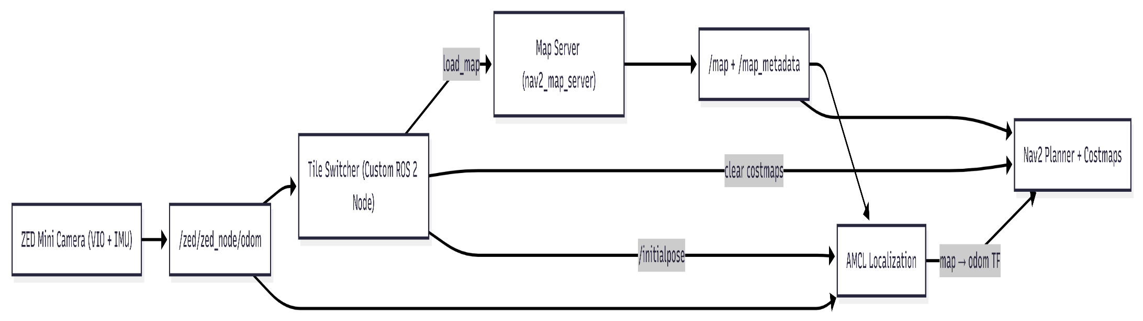
2)NAV2_AMCL:
Subscribes:
/map (OccupancyGrid)
/scan or depth data (sensor input)
/odom (robot motion)
Publishes:
/amcl_pose → Estimated robot pose in map frame
map → odom TF transform
3)NAV2_PLANNER:
Subscribes:
/map
/tf
/amcl_pose
1)MAP_SERVER :
Publishes:
/map → nav_msgs/OccupancyGrid
/map_metadata → nav_msgs/MapMetaData
Services:
/map_server/load_map → Load a new map at runtime
4)TILE_SWITCHER:
Subscribes:
/zed/zed_node/odom → Robot motion
Publishes:
/initialpose → Reinitialize AMCL after map switch

Slide 21
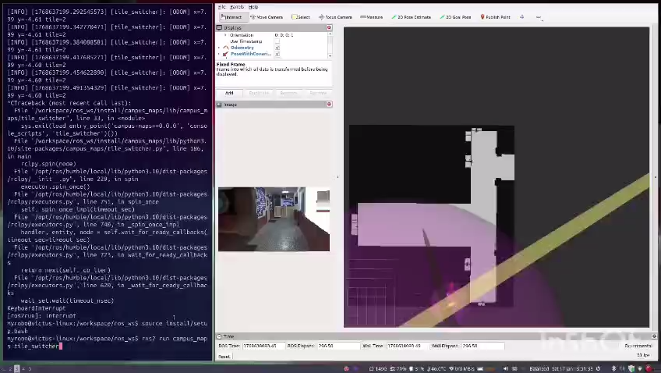
Map Switching Sequence
Robot navigates using Tile 1
Tile Switcher monitors odometry
Boundary condition is detected
Map Server loads Tile 2
AMCL is reinitialized with a known pose
Nav2 resumes planning

Slide 22
Work split up among the members (in accordance with the work progress after the zeroth review)
Member | Tasks
Lalithesh K | Map Creation, Map Splitting, Map Switching
Tejas M K | Aruco Localisation, Aruco Evaluation, PCB Layout, Jetson Setup, Dockerized System Setup
Preetham M | CAD, Fabrication, Circuit Schematic

Slide 23
Next tasks
PCB Fabrication
Electronics Assembly
Integration of Aruco based localisation with IMU and Odometry
Global Path Planning Algorithm
Autonomous Run using Global Planner

Slide 24
Thank You

